Slide 1
Money Management on The Go
CS4398.251 - Software Engineering
Group3:
- Moheddin, Adnan M.
- Motiwala Memon, Muhammed S.
- Midorikawa, Eri T.

Slide 2
purpose
Many students have problems to manage their money (overspending, didn’t track income, etc.)
This app helps them to keep track their financial situation.
Able to input transactions manually
Show a graph for monthly income/spending
Keep track their saving pattern

Slide 3
Problems
Lacking of knowledge about front-end technologies – none of us are experienced in front-end development.
Unsuccessfully connecting back-end and front-end
Personal Issues: A team member gets sick, can’t get the code to run on their laptop, etc.
Time conflicts: Inverted class schedules, some of us stayed up late while others woke up early.
Software Issues: Database issues, function issues, connecting frontend and backend.

Slide 4
INITIAL Solutions
Software Issues: We compiled code on online resources such as github codespaces, we created unit tests, we switched the software we were using.
Time Conflicts: We told each other what we want via messages and emails instead of setting meetings up.
Personal Issues: We informed each other of any issues and one person could fill in for another.
Lack of front-end knowledge: We simply researched! We researched how to get the front end and the back end together, and we researched several tools.

Slide 5
Additional problems
Software Issues: Most of our issues at this point was for both frontend and backend to implement the database. The only other issues were when one team member created a function that behaved slightly differently than what another team member had envisioned.
Time Conflicts: Although we “solved” this by messaging each other, we learned that some issues are specific and we had to meet up to give a properly in-depth explanation for the issue.
Personal Issues: We had one person be sick during this time, but we were largely free of any personal issues.
Lack of front-end knowledge: We needed to research a bit more.

Slide 6
Final Solutions
Software Issues: Since we didn’t necessarily need a database, we decided to use a .txt file as a temporary way to store file data.
Time Conflicts: Although we “solved” this by messaging each other, we learned that some issues are specific and we had to meet up to give a properly in-depth explanation for the issue.
Personal Issues: We had one person be sick during this time, but we were largely free of any personal issues.
Lack of front-end knowledge: We needed to research a bit more.

Slide 7
Code
Github: https://github.com/signm4/moneyMgmt_cs4398

Slide 8
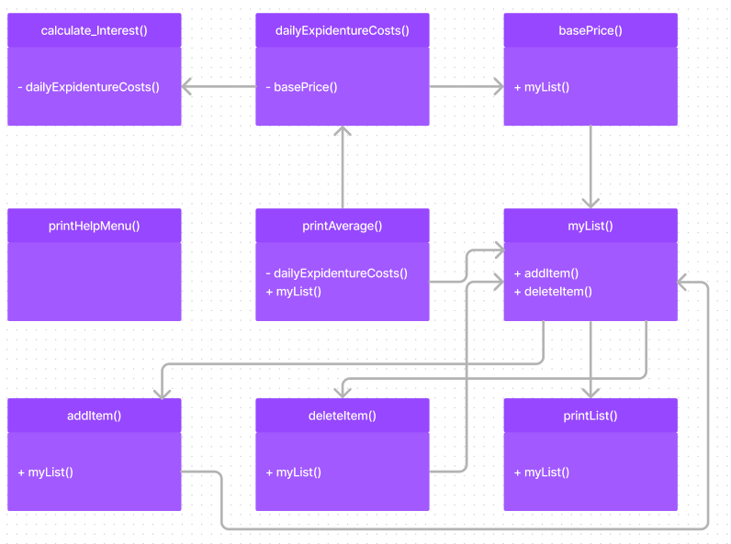
UML DIAGRAM

Slide 9
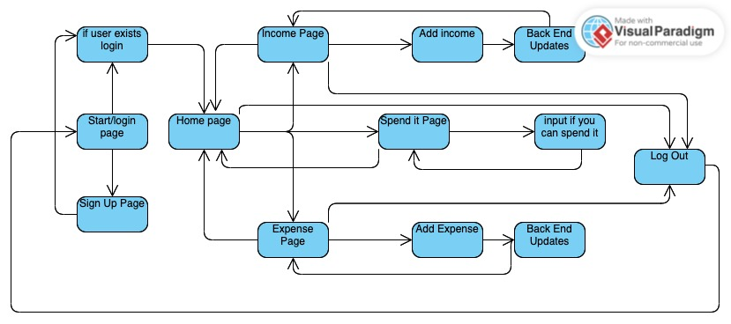
State Chart diagram

Slide 10
Test cases

Slide 11
Retrospective
Learned new technologies through the difficult project such as REACT and handling databases
Needed efficient communication
Needed to organize our task efficiently

